Slide 1
Data Mining:
Concepts and Techniques
— Chapter 6 —
Jiawei Han
Department of Computer Science
University of Illinois at Urbana-Champaign
www.cs.uiuc.edu/~hanj
©2006 Jiawei Han and Micheline Kamber, All rights reserved

Slide 2
Chapter 6. Classification and Prediction
What is classification? What is prediction?
Issues regarding classification and prediction
Classification by decision tree induction
Bayesian classification
Rule-based classification
Classification by back propagation
Support Vector Machines (SVM)
Associative classification
Lazy learners (or learning from your neighbors)
Other classification methods
Prediction
Accuracy and error measures
Ensemble methods
Model selection
Summary

Slide 3
Classification vs. Prediction
Classification
  predicts categorical class labels (discrete or nominal)
  classifies data (constructs a model) based on the training set and the values (class labels) in a classifying attribute and uses it in classifying new data
Prediction
  models continuous-valued functions, i.e., predicts unknown or missing values
Typical applications
  Credit approval
  Target marketing
  Medical diagnosis
  Fraud detection

Slide 4
Classification—A Two-Step Process
Model construction: describing a set of predetermined classes
  Each tuple/sample is assumed to belong to a predefined class, as determined by the class label attribute
  The set of tuples used for model construction is training set
  The model is represented as classification rules, decision trees, or mathematical formulae
Model usage: for classifying future or unknown objects
  Estimate accuracy of the model
    The known label of test sample is compared with the classified result from the model
    Accuracy rate is the percentage of test set samples that are correctly classified by the model
    Test set is independent of training set, otherwise over-fitting will occur
  If the accuracy is acceptable, use the model to classify data tuples whose class labels are not known

Slide 5



Process (1): Model Construction
Classification
Algorithms
Training
Data
Classifier
(Model)
IF rank = ‘professor’
OR years > 6
THEN tenured = ‘yes’

Slide 6




Process (2): Using the Model in Prediction
Classifier
Testing
Data
Unseen Data
(Jeff, Professor, 4)
Tenured?

Slide 7
Supervised vs. Unsupervised Learning
Supervised learning (classification)
  Supervision: The training data (observations, measurements, etc.) are accompanied by labels indicating the class of the observations
  New data is classified based on the training set
Unsupervised learning (clustering)
  The class labels of training data is unknown
  Given a set of measurements, observations, etc. with the aim of establishing the existence of classes or clusters in the data

Slide 8
Chapter 6. Classification and Prediction
What is classification? What is prediction?
Issues regarding classification and prediction
Classification by decision tree induction
Bayesian classification
Rule-based classification
Classification by back propagation
Support Vector Machines (SVM)
Associative classification
Lazy learners (or learning from your neighbors)
Other classification methods
Prediction
Accuracy and error measures
Ensemble methods
Model selection
Summary

Slide 9
Issues: Data Preparation
Data cleaning
  Preprocess data in order to reduce noise and handle missing values
Relevance analysis (feature selection)
  Remove the irrelevant or redundant attributes
Data transformation
  Generalize and/or normalize data

Slide 10
Issues: Evaluating Classification Methods
Accuracy
  classifier accuracy: predicting class label
  predictor accuracy: guessing value of predicted attributes
Speed
  time to construct the model (training time)
  time to use the model (classification/prediction time)
Robustness: handling noise and missing values
Scalability: efficiency in disk-resident databases
Interpretability
  understanding and insight provided by the model
Other measures, e.g., goodness of rules, such as decision tree size or compactness of classification rules

Slide 11
Chapter 6. Classification and Prediction
What is classification? What is prediction?
Issues regarding classification and prediction
Classification by decision tree induction
Bayesian classification
Rule-based classification
Classification by back propagation
Support Vector Machines (SVM)
Associative classification
Lazy learners (or learning from your neighbors)
Other classification methods
Prediction
Accuracy and error measures
Ensemble methods
Model selection
Summary

Slide 12

Example of a Decision Tree
categorical
categorical
continuous
class
Splitting Attributes
Refund
Yes
No
NO
MarSt
Single, Divorced
Married
TaxInc
NO
< 80K
> 80K
NO
YES
Training Data
Model: Decision Tree

Slide 13
Another Example of Decision Tree
categorical
categorical
continuous
class
MarSt
Single, Divorced
Married
NO
Refund
Yes
No
NO
TaxInc
< 80K
> 80K
NO
YES
There could be more than one tree that fits the same data!

Slide 14

Decision Tree Classification Task
Decision Tree

Slide 15

Apply Model to Test Data
Test Data
Start from the root of tree.
Refund
Yes
No
NO
MarSt
Single, Divorced
Married
TaxInc
NO
< 80K
> 80K
NO
YES

Slide 16
Apply Model to Test Data
Test Data
Refund
Yes
No
NO
MarSt
Single, Divorced
Married
TaxInc
NO
< 80K
> 80K
NO
YES

Slide 17

Apply Model to Test Data
Test Data
Refund
Yes
No
NO
MarSt
Single, Divorced
Married
TaxInc
NO
< 80K
> 80K
NO
YES

Slide 18
Apply Model to Test Data
Test Data
Refund
Yes
No
NO
MarSt
Single, Divorced
Married
TaxInc
NO
< 80K
> 80K
NO
YES

Slide 19

Apply Model to Test Data
Test Data
Refund
Yes
No
NO
MarSt
Single, Divorced
Married
TaxInc
NO
< 80K
> 80K
NO
YES

Slide 20
Apply Model to Test Data
Test Data
Refund
Yes
No
NO
MarSt
Single, Divorced
Married
Assign Cheat to “No”
TaxInc
NO
< 80K
> 80K
NO
YES

Slide 21

Decision Tree Classification Task
Decision Tree

Slide 22
Algorithm for Decision Tree Induction
Basic algorithm (a greedy algorithm)
  Tree is constructed in a top-down recursive divide-and-conquer manner
  At start, all the training examples are at the root
  Attributes are categorical (if continuous-valued, they are discretized in advance)
  Examples are partitioned recursively based on selected attributes
  Test attributes are selected on the basis of a heuristic or statistical measure (e.g., information gain)
Conditions for stopping partitioning
  All samples for a given node belong to the same class
  There are no remaining attributes for further partitioning – majority voting is employed for classifying the leaf
  There are no samples left

Slide 23
Decision Tree Induction
Many Algorithms:
  Hunt’s Algorithm (one of the earliest)
  CART
  ID3, C4.5
  SLIQ,SPRINT

Slide 24

General Structure of Hunt’s Algorithm
Let D_{t} be the set of training records that reach a node t
General Procedure:
  If D_{t} contains records that belong the same class y_{t}, then t is a leaf node labeled as y_{t}
  If D_{t} is an empty set, then t is a leaf node labeled by the default class, y_{d}
  If D_{t} contains records that belong to more than one class, use an attribute test to split the data into smaller subsets. Recursively apply the procedure to each subset.
D_{t}
?

Slide 25

Hunt’s Algorithm
Refund
Don’t
Cheat
Yes
No
Don’t
Cheat
Don’t
Cheat
Refund
Refund
Yes
No
Yes
No
Don’t
Cheat
Marital
Status
Don’t
Cheat
Marital
Status
Single,
Divorced
Single,
Divorced
Married
Married
Cheat
Don’t
Cheat
Taxable
Income
Don’t
Cheat
< 80K
>= 80K
Don’t
Cheat
Cheat

Slide 26
Tree Induction
Greedy strategy.
  Split the records based on an attribute test that optimizes certain criterion.
Issues
  Determine how to split the records
    How to specify the attribute test condition?
    How to determine the best split?
  Determine when to stop splitting

Slide 27
Tree Induction
Greedy strategy.
  Split the records based on an attribute test that optimizes certain criterion.
Issues
  Determine how to split the records
    How to specify the attribute test condition?
    How to determine the best split?
  Determine when to stop splitting

Slide 28
How to Specify Test Condition?
Depends on attribute types
  Nominal
  Ordinal
  Continuous
Depends on number of ways to split
  2-way split
  Multi-way split

Slide 29
Splitting Based on Nominal Attributes
Multi-way split: Use as many partitions as distinct values.
Binary split: Divides values into two subsets.
Need to find optimal partitioning.
CarType
Family
Luxury
Sports
CarType
CarType
{Sports, Luxury}
OR
{Family,
Luxury}
{Family}
{Sports}

Slide 30
Splitting Based on Ordinal Attributes
Multi-way split: Use as many partitions as distinct values.
Binary split: Divides values into two subsets.
Need to find optimal partitioning.
What about this split?
Size
Small
Large
Medium
Size
Size
{Small, Medium}
OR
{Medium,
Large}
{Large}
{Small}
Size
{Small, Large}
{Medium}

Slide 31
Splitting Based on Continuous Attributes
Different ways of handling
  Discretization to form an ordinal categorical attribute
    Static – discretize once at the beginning
    Dynamic – ranges can be found by equal interval bucketing, equal frequency bucketing
    (percentiles), or clustering.
  Binary Decision: (A < v) or (A ≥ v)
    consider all possible splits and finds the best cut
    can be more compute intensive

Slide 32
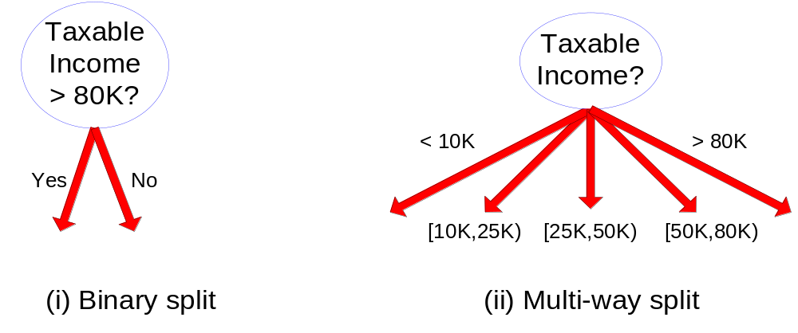
Splitting Based on Continuous Attributes

Slide 33
Tree Induction
Greedy strategy.
  Split the records based on an attribute test that optimizes certain criterion.
Issues
  Determine how to split the records
    How to specify the attribute test condition?
    How to determine the best split?
  Determine when to stop splitting

Slide 34

How to determine the Best Split
Before Splitting: 10 records of class 0,
10 records of class 1
Which test condition is the best?

Slide 35
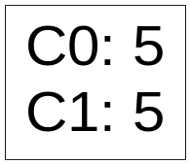
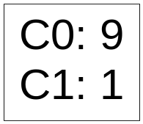
How to determine the Best Split
Greedy approach:
  Nodes with homogeneous class distribution are preferred
Need a measure of node impurity:
Non-homogeneous,
High degree of impurity
Homogeneous,
Low degree of impurity

Slide 36
Measures of Node Impurity
Gini Index
Entropy
Misclassification error

Slide 37





How to Find the Best Split
Before Splitting:
M0
A?
B?
Yes
No
Yes
No
Node N1
Node N2
Node N3
Node N4
M1
M2
M3
M4
M12
M34
Gain = M0 – M12 vs M0 – M34

Slide 38
Examples
Using Information Gain

Slide 39
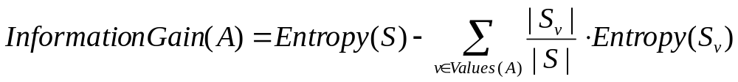
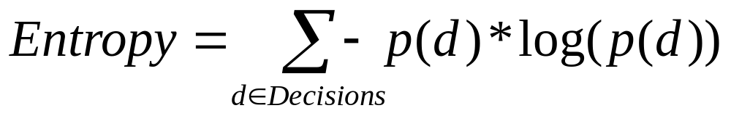
Information Gain in a Nutshell
typically yes/no

Slide 40
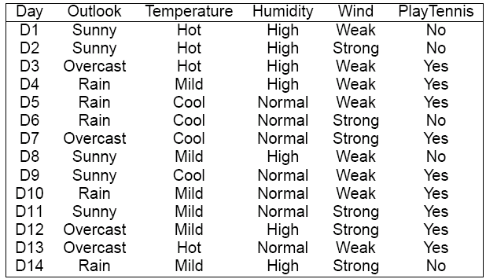
Playing Tennis

Slide 41
Choosing an Attribute
We want to split our decision tree on one of the attributes
There are four attributes to choose from:
  Outlook
  Temperature
  Humidity
  Wind

Slide 42
How to Choose an Attribute
Want to calculated the information gain of each attribute
Let us start with Outlook
What is Entropy(S)?
-5/14*log2(5/14) – 9/14*log2(9/14)
= Entropy(5/14,9/14) = 0.9403

Slide 43
Outlook Continued
The expected conditional entropy is:
5/14 * Entropy(3/5,2/5) +
4/14 * Entropy(1,0) +
5/14 * Entropy(3/5,2/5) = 0.6935
So IG(Outlook) = 0.9403 – 0.6935 = 0.2468

Slide 44
Temperature
Now let us look at the attribute Temperature
The expected conditional entropy is:
4/14 * Entropy(2/4,2/4) +
6/14 * Entropy(4/6,2/6) +
4/14 * Entropy(3/4,1/4) = 0.9111
So IG(Temperature) = 0.9403 – 0.9111 = 0.0292

Slide 45
Humidity
Now let us look at attribute Humidity
What is the expected conditional entropy?
7/14 * Entropy(4/7,3/7) +
7/14 * Entropy(6/7,1/7) = 0.7885
So IG(Humidity) = 0.9403 – 0.7885
= 0.1518

Slide 46
Wind
What is the information gain for wind?
Expected conditional entropy:
8/14 * Entropy(6/8,2/8) +
6/14 * Entropy(3/6,3/6) = 0.8922
IG(Wind) = 0.9403 – 0.8922 = 0.048

Slide 47
Information Gains
Outlook 0.2468
Temperature 0.0292
Humidity 0.1518
Wind 0.0481
We choose Outlook since it has the highest information gain

Slide 48
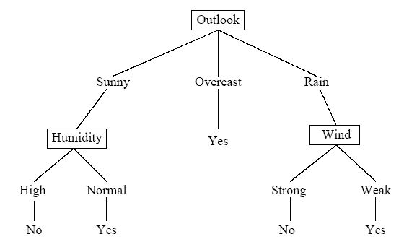
Decision Tree So Far
Now must decide what to do when Outlook is:
  Sunny
  Overcast
  Rain

Slide 49
Sunny Branch
Examples to classify:
Temperature, Humidity, Wind, Tennis
Hot, High, Weak, no
Hot, High, Strong, no
Mild, High, Weak, no
Cool, Normal, Weak, yes
Mild, Normal, Strong, yes

Slide 50
Splitting Sunny on Temperature
What is the Entropy of Sunny?
  Entropy(2/5,3/5) = 0.9710
How about the expected utility?
  2/5 * Entropy(1,0) +
  2/5 * Entropy(1/2,1/2) +
  1/5 * Entropy(1,0) = 0.4000
IG(Temperature) = 0.9710 – 0.4000
= 0.5710

Slide 51
Splitting Sunny on Humidity
The expected conditional entropy is
3/5 * Entropy(1,0) +
2/5 * Entropy(1,0) = 0
IG(Humidity) = 0.9710 – 0 = 0.9710

Slide 52
Considering Wind?
Do we need to consider wind as an attribute?
No – it is not possible to do any better than an expected entropy of 0; i.e. humidity must maximize the information gain

Slide 53
New Tree

Slide 54
What if it is Overcast?
All examples indicate yes
So there is no need to further split on an attribute
The information gain for any attribute would have to be 0
Just write yes at this node

Slide 55
New Tree

Slide 56
What about Rain?
Let us consider attribute temperature
First, what is the entropy of the data?
  Entropy(3/5,2/5) = 0.9710
Second, what is the expected conditional entropy?
  3/5 * Entropy(2/3,1/3) + 2/5 * Entropy(1/2,1/2) = 0.9510
IG(Temperature) = 0.9710 – 0.9510 = 0.020

Slide 57
Or perhaps humidity?
What is the expected conditional entropy?
  3/5 * Entropy(2/3,1/3) + 2/5 * Entropy(1/2,1/2) = 0.9510 (the same)
IG(Humidity) = 0.9710 – 0.9510 = 0.020 (again, the same)

Slide 58
Now consider wind
Expected conditional entropy:
  3/5*Entropy(1,0) + 2/5*Entropy(1,0) = 0
IG(Wind) = 0.9710 – 0 = 0.9710
Thus, we split on Wind

Slide 59
Split Further?

Slide 60
Final Tree

Slide 61






Attribute Selection: Information Gain
Class P: buys_computer = “yes”
Class N: buys_computer = “no”
means “age <=30” has 5 out of 14 samples, with 2 yes’es and 3 no’s. Hence
Similarly,

Slide 62
Computing Information-Gain for Continuous-Value Attributes
Let attribute A be a continuous-valued attribute
Must determine the best split point for A
  Sort the value A in increasing order
  Typically, the midpoint between each pair of adjacent values is considered as a possible split point
    (a_{i}+a_{i+1})/2 is the midpoint between the values of a_{i} and a_{i+1}
  The point with the minimum expected information requirement for A is selected as the split-point for A
Split:
  D1 is the set of tuples in D satisfying A ≤ split-point, and D2 is the set of tuples in D satisfying A > split-point

Slide 63

Gain Ratio for Attribute Selection (C4.5)
Information gain measure is biased towards attributes with a large number of values
C4.5 (a successor of ID3) uses gain ratio to overcome the problem (normalization to information gain)
  GainRatio(A) = Gain(A)/SplitInfo(A)
Ex.
  gain_ratio(income) = 0.029/0.926 = 0.031
The attribute with the maximum gain ratio is selected as the splitting attribute

Slide 64



Gini index (CART, IBM IntelligentMiner)
If a data set D contains examples from n classes, gini index, gini(D) is defined as
where p_{j} is the relative frequency of class j in D
If a data set D is split on A into two subsets D₁ and D₂, the gini index gini(D) is defined as
Reduction in Impurity:
The attribute provides the smallest gini_{split}(D) (or the largest reduction in impurity) is chosen to split the node (need to enumerate all the possible splitting points for each attribute)

Slide 65


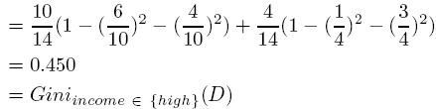
Gini index (CART, IBM IntelligentMiner)
Ex. D has 9 tuples in buys_computer = “yes” and 5 in “no”
Suppose the attribute income partitions D into 10 in D₁: {low, medium} and 4 in D₂
  but gini_{{medium,high}} is 0.30 and thus the best since it is the lowest
All attributes are assumed continuous-valued
May need other tools, e.g., clustering, to get the possible split values
Can be modified for categorical attributes

Slide 66
Comparing Attribute Selection Measures
The three measures, in general, return good results but
  Information gain:
    biased towards multivalued attributes
  Gain ratio:
    tends to prefer unbalanced splits in which one partition is much smaller than the others
  Gini index:
    biased to multivalued attributes
    has difficulty when # of classes is large
    tends to favor tests that result in equal-sized partitions and purity in both partitions

Slide 67
Other Attribute Selection Measures
CHAID: a popular decision tree algorithm, measure based on χ² test for independence
C-SEP: performs better than info. gain and gini index in certain cases
G-statistics: has a close approximation to χ² distribution
MDL (Minimal Description Length) principle (i.e., the simplest solution is preferred):
  The best tree as the one that requires the fewest # of bits to both (1) encode the tree, and (2) encode the exceptions to the tree
Multivariate splits (partition based on multiple variable combinations)
  CART: finds multivariate splits based on a linear comb. of attrs.
Which attribute selection measure is the best?
  Most give good results, none is significantly superior than others

Slide 68
Overfitting and Tree Pruning
Overfitting: An induced tree may overfit the training data
  Too many branches, some may reflect anomalies due to noise or outliers
  Poor accuracy for unseen samples
Two approaches to avoid overfitting
  Prepruning: Halt tree construction early—do not split a node if this would result in the goodness measure falling below a threshold
    Difficult to choose an appropriate threshold
  Postpruning: Remove branches from a “fully grown” tree—get a sequence of progressively pruned trees
    Use a set of data different from the training data to decide which is the “best pruned tree”

Slide 69

Underfitting and Overfitting
Overfitting
Underfitting: when model is too simple, both training and test errors are large

Slide 70
Overfitting in Classification
Overfitting: An induced tree may overfit the training data
  Too many branches, some may reflect anomalies due to noise or outliers
  Poor accuracy for unseen samples

Slide 71
Enhancements to Basic Decision Tree Induction
Allow for continuous-valued attributes
  Dynamically define new discrete-valued attributes that partition the continuous attribute value into a discrete set of intervals
Handle missing attribute values
  Assign the most common value of the attribute
  Assign probability to each of the possible values
Attribute construction
  Create new attributes based on existing ones that are sparsely represented
  This reduces fragmentation, repetition, and replication

Slide 72
Classification in Large Databases
Classification—a classical problem extensively studied by statisticians and machine learning researchers
Scalability: Classifying data sets with millions of examples and hundreds of attributes with reasonable speed
Why decision tree induction in data mining?
  relatively faster learning speed (than other classification methods)
  convertible to simple and easy to understand classification rules
  can use SQL queries for accessing databases
  comparable classification accuracy with other methods

Slide 73
Scalable Decision Tree Induction Methods
SLIQ (EDBT’96 — Mehta et al.)
  Builds an index for each attribute and only class list and the current attribute list reside in memory
SPRINT (VLDB’96 — J. Shafer et al.)
  Constructs an attribute list data structure
PUBLIC (VLDB’98 — Rastogi & Shim)
  Integrates tree splitting and tree pruning: stop growing the tree earlier
RainForest (VLDB’98 — Gehrke, Ramakrishnan & Ganti)
  Builds an AVC-list (attribute, value, class label)
BOAT (PODS’99 — Gehrke, Ganti, Ramakrishnan & Loh)
  Uses bootstrapping to create several small samples

Slide 74
Scalability Framework for RainForest
Separates the scalability aspects from the criteria that determine the quality of the tree
Builds an AVC-list: AVC (Attribute, Value, Class_label)
AVC-set (of an attribute X )
  Projection of training dataset onto the attribute X and class label where counts of individual class label are aggregated
AVC-group (of a node n )
  Set of AVC-sets of all predictor attributes at the node n

Slide 75

Rainforest: Training Set and Its AVC Sets
Training Examples
AVC-set on Age
AVC-set on income
Age | Buy_Computer
 | yes | no
<=30 | 3 | 2
31..40 | 4 | 0
>40 | 3 | 2
income | Buy_Computer
 | yes | no
high | 2 | 2
medium | 4 | 2
low | 3 | 1
AVC-set on
credit_rating
AVC-set on Student
student | Buy_Computer
 | yes | no
yes | 6 | 1
no | 3 | 4
Credit rating | Buy_Computer
 | yes | no
fair | 6 | 2
excellent | 3 | 3

Slide 76
Chapter 6. Classification and Prediction
What is classification? What is prediction?
Issues regarding classification and prediction
Classification by decision tree induction
Bayesian classification
Rule-based classification
Classification by back propagation
Support Vector Machines (SVM)
Associative classification
Lazy learners (or learning from your neighbors)
Other classification methods
Prediction
Accuracy and error measures
Ensemble methods
Model selection
Summary

Slide 77
Bayesian Classification: Why?
A statistical classifier: performs probabilistic prediction, i.e., predicts class membership probabilities
Foundation: Based on Bayes’ Theorem.
Performance: A simple Bayesian classifier, naïve Bayesian classifier, has comparable performance with decision tree and selected neural network classifiers
Incremental: Each training example can incrementally increase/decrease the probability that a hypothesis is correct — prior knowledge can be combined with observed data
Standard: Even when Bayesian methods are computationally intractable, they can provide a standard of optimal decision making against which other methods can be measured

Slide 78
Bayesian Theorem: Basics
Let X be a data sample (“evidence”): class label is unknown
Let H be a hypothesis that X belongs to class C
Classification is to determine P(H|X), the probability that the hypothesis holds given the observed data sample X
P(H) (prior probability), the initial probability
  E.g., X will buy computer, regardless of age, income, …
P(X): probability that sample data is observed
P(X|H) (posteriori probability), the probability of observing the sample X, given that the hypothesis holds
  E.g., Given that X will buy computer, the prob. that X is 31..40, medium income

Slide 79
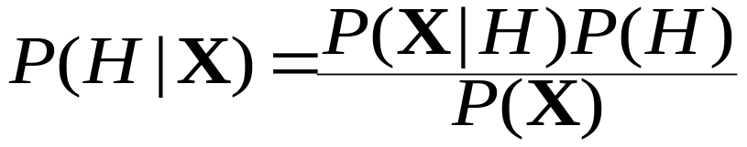
Bayesian Theorem
Given training data X, posteriori probability of a hypothesis H, P(H|X), follows the Bayes theorem
Informally, this can be written as
  posteriori = likelihood x prior/evidence
Predicts X belongs to C₂ iff the probability P(C_{i}|X) is the highest among all the P(C_{k}|X) for all the k classes
Practical difficulty: require initial knowledge of many probabilities, significant computational cost

Slide 80


Towards Naïve Bayesian Classifier
Let D be a training set of tuples and their associated class labels, and each tuple is represented by an n-D attribute vector X = (x₁, x₂, …, x_{n})
Suppose there are m classes C₁, C₂, …, C_{m}.
Classification is to derive the maximum posteriori, i.e., the maximal P(C_{i}|X)
This can be derived from Bayes’ theorem
Since P(X) is constant for all classes, only
  needs to be maximized

Slide 81
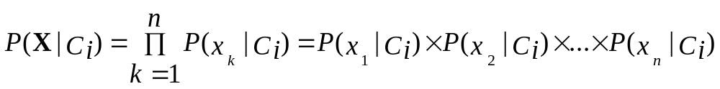
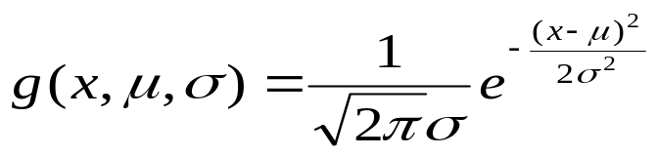

Derivation of Naïve Bayes Classifier
A simplified assumption: attributes are conditionally independent (i.e., no dependence relation between attributes):
This greatly reduces the computation cost: Only counts the class distribution
If A_{k} is categorical, P(x_{k}|C_{i}) is the # of tuples in C_{i} having value x_{k} for A_{k} divided by |C_{i, D}| (# of tuples of C_{i} in D)
If A_{k} is continous-valued, P(x_{k}|C_{i}) is usually computed based on Gaussian distribution with a mean μ and standard deviation σ
  and P(x_{k}|C_{i}) is

Slide 82

Naïve Bayesian Classifier: Training Dataset
Class:
C1:buys_computer = ‘yes’
C2:buys_computer = ‘no’
Data sample
X = (age <=30,
Income = medium,
Student = yes
Credit_rating = Fair)

Slide 83
Naïve Bayesian Classifier: An Example
P(C_{i}): P(buys_computer = “yes”) = 9/14 = 0.643
P(buys_computer = “no”) = 5/14= 0.357
Compute P(X|C_{i}) for each class
P(age = “<=30” | buys_computer = “yes”) = 2/9 = 0.222
P(age = “<= 30” | buys_computer = “no”) = 3/5 = 0.6
P(income = “medium” | buys_computer = “yes”) = 4/9 = 0.444
P(income = “medium” | buys_computer = “no”) = 2/5 = 0.4
P(student = “yes” | buys_computer = “yes) = 6/9 = 0.667
P(student = “yes” | buys_computer = “no”) = 1/5 = 0.2
P(credit_rating = “fair” | buys_computer = “yes”) = 6/9 = 0.667
P(credit_rating = “fair” | buys_computer = “no”) = 2/5 = 0.4
X = (age <= 30 , income = medium, student = yes, credit_rating = fair)
P(X|C_{i}) : P(X|buys_computer = “yes”) = 0.222 x 0.444 x 0.667 x 0.667 = 0.044
P(X|buys_computer = “no”) = 0.6 x 0.4 x 0.2 x 0.4 = 0.019
P(X|C_{i})*P(C_{i}) : P(X|buys_computer = “yes”) * P(buys_computer = “yes”) = 0.028
P(X|buys_computer = “no”) * P(buys_computer = “no”) = 0.007
Therefore, X belongs to class (“buys_computer = yes”)

Slide 84
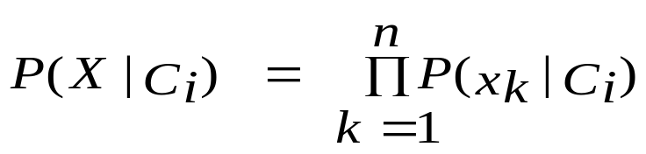
Avoiding the 0-Probability Problem
Naïve Bayesian prediction requires each conditional prob. be non-zero. Otherwise, the predicted prob. will be zero
Ex. Suppose a dataset with 1000 tuples, income=low (0), income= medium (990), and income = high (10),
Use Laplacian correction (or Laplacian estimator)
  Adding 1 to each case
    Prob(income = low) = 1/1003
    Prob(income = medium) = 991/1003
    Prob(income = high) = 11/1003
  The “corrected” prob. estimates are close to their “uncorrected” counterparts

Slide 85
Naïve Bayesian Classifier: Comments
Advantages
  Easy to implement
  Good results obtained in most of the cases
Disadvantages
  Assumption: class conditional independence, therefore loss of accuracy
  Practically, dependencies exist among variables
    E.g., hospitals: patients: Profile: age, family history, etc.
    Symptoms: fever, cough etc., Disease: lung cancer, diabetes, etc.
    Dependencies among these cannot be modeled by Naïve Bayesian Classifier
How to deal with these dependencies?
  Bayesian Belief Networks

Slide 86
Chapter 6. Classification and Prediction
What is classification? What is prediction?
Issues regarding classification and prediction
Classification by decision tree induction
Bayesian classification
Rule-based classification
Classification by back propagation
Support Vector Machines (SVM)
Associative classification
Lazy learners (or learning from your neighbors)
Other classification methods
Prediction
Accuracy and error measures
Ensemble methods
Model selection
Summary

Slide 87
Rule-Based Classifier
Classify records by using a collection of “if…then…” rules
Rule: (Condition) → y
  where
    Condition is a conjunctions of attributes
    y is the class label
  LHS: rule antecedent or condition
  RHS: rule consequent
  Examples of classification rules:
    (Blood Type=Warm) ∧ (Lay Eggs=Yes) → Birds
    (Taxable Income < 50K) ∧ (Refund=Yes) → Evade=No

Slide 88
Rule Extraction from a Decision Tree
age?
<=30
31..40
>40
Rules are easier to understand than large trees
One rule is created for each path from the root to a leaf
Each attribute-value pair along a path forms a conjunction: the leaf holds the class prediction
Rules are mutually exclusive and exhaustive
student?
yes
credit rating?
no
yes
excellent
fair
no
yes
no
yes
Example: Rule extraction from our buys_computer decision-tree
  IF age = young AND student = no THEN buys_computer = no
  IF age = young AND student = yes THEN buys_computer = yes
  IF age = mid-age THEN buys_computer = yes
  IF age = old AND credit_rating = excellent THEN buys_computer = yes
  IF age = young AND credit_rating = fair THEN buys_computer = no

Slide 89
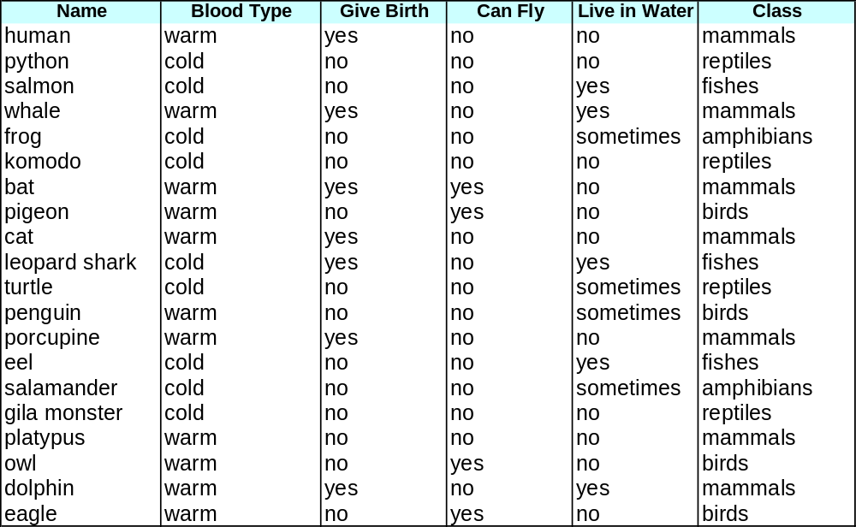
Rule-based Classifier (Example)
R1: (Give Birth = no) ∧ (Can Fly = yes) → Birds
R2: (Give Birth = no) ∧ (Live in Water = yes) → Fishes
R3: (Give Birth = yes) ∧ (Blood Type = warm) → Mammals
R4: (Give Birth = no) ∧ (Can Fly = no) → Reptiles
R5: (Live in Water = sometimes) → Amphibians

Slide 90
Application of Rule-Based Classifier
A rule r covers an instance x if the attributes of the instance satisfy the condition of the rule
R1: (Give Birth = no) ∧ (Can Fly = yes) → Birds
R2: (Give Birth = no) ∧ (Live in Water = yes) → Fishes
R3: (Give Birth = yes) ∧ (Blood Type = warm) → Mammals
R4: (Give Birth = no) ∧ (Can Fly = no) → Reptiles
R5: (Live in Water = sometimes) → Amphibians
The rule R1 covers a hawk => Bird
The rule R3 covers the grizzly bear => Mammal

Slide 91
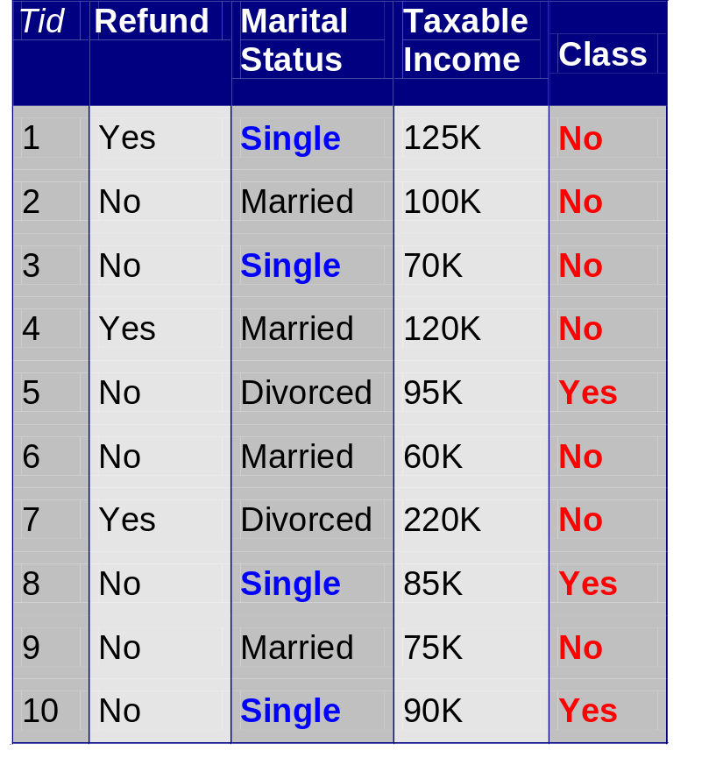
Rule Coverage and Accuracy
Coverage of a rule:
  Fraction of records that satisfy the antecedent of a rule
Accuracy of a rule:
  Fraction of records that satisfy both the antecedent and consequent of a rule
(Status=Single) → No
Coverage = 40%, Accuracy = 50%

Slide 92
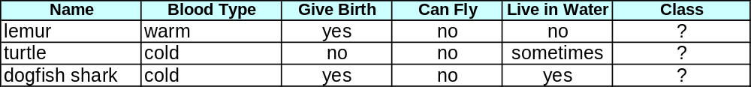
How does Rule-based Classifier Work?
R1: (Give Birth = no) ∧ (Can Fly = yes) → Birds
R2: (Give Birth = no) ∧ (Live in Water = yes) → Fishes
R3: (Give Birth = yes) ∧ (Blood Type = warm) → Mammals
R4: (Give Birth = no) ∧ (Can Fly = no) → Reptiles
R5: (Live in Water = sometimes) → Amphibians
A lemur triggers rule R3, so it is classified as a mammal
A turtle triggers both R4 and R5
A dogfish shark triggers none of the rules

Slide 93
Characteristics of Rule-Based Classifier
Mutually exclusive rules
  Classifier contains mutually exclusive rules if the rules are independent of each other
  Every record is covered by at most one rule
Exhaustive rules
  Classifier has exhaustive coverage if it accounts for every possible combination of attribute values
  Each record is covered by at least one rule

Slide 94
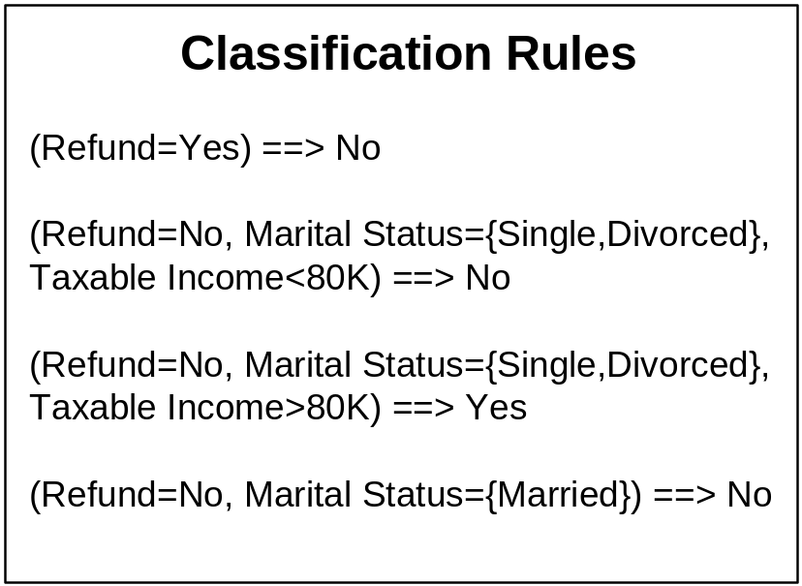
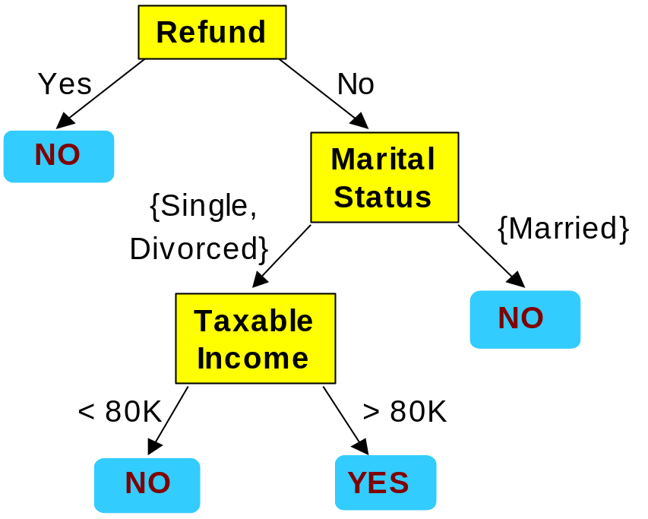
From Decision Trees To Rules
Rules are mutually exclusive and exhaustive
Rule set contains as much information as the tree

Slide 95
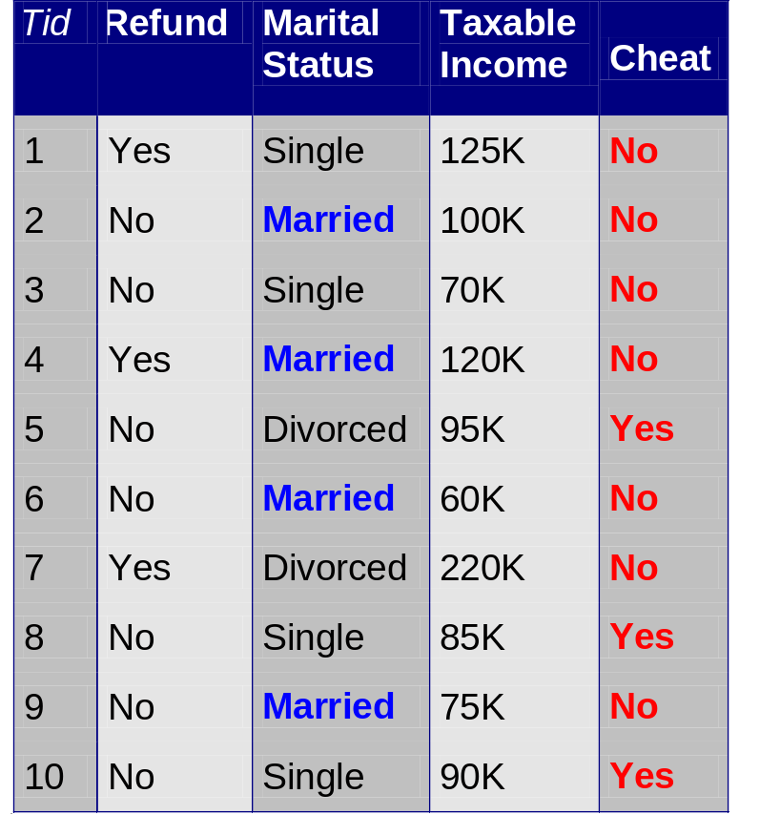
Rules Can Be Simplified
Initial Rule: (Refund=No) ∧ (Status=Married) → No
Simplified Rule: (Status=Married) → No

Slide 96
Effect of Rule Simplification
Rules are no longer mutually exclusive
  A record may trigger more than one rule
  Solution?
    Ordered rule set
    Unordered rule set – use voting schemes
Rules are no longer exhaustive
  A record may not trigger any rules
  Solution?
    Use a default class

Slide 97
Ordered Rule Set
Rules are rank ordered according to their priority
  An ordered rule set is known as a decision list
When a test record is presented to the classifier
  It is assigned to the class label of the highest ranked rule it has triggered
  If none of the rules fired, it is assigned to the default class
R1: (Give Birth = no) ∧ (Can Fly = yes) → Birds
R2: (Give Birth = no) ∧ (Live in Water = yes) → Fishes
R3: (Give Birth = yes) ∧ (Blood Type = warm) → Mammals
R4: (Give Birth = no) ∧ (Can Fly = no) → Reptiles
R5: (Live in Water = sometimes) → Amphibians

Slide 98
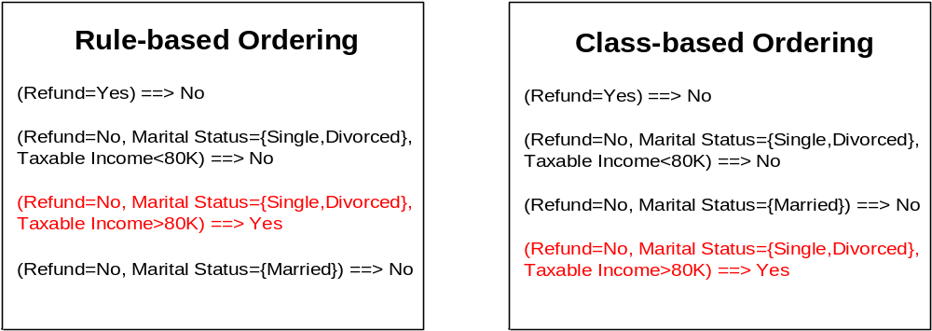
Rule Ordering Schemes
Rule-based ordering
  Individual rules are ranked based on their quality
Class-based ordering
  Rules that belong to the same class appear together

Slide 99
Building Classification Rules
Direct Method:
    Extract rules directly from data
    e.g.: RIPPER, CN2, Holte’s 1R
Indirect Method:
    Extract rules from other classification models (e.g.
    decision trees, neural networks, etc).
    e.g: C4.5rules

Slide 100
Rule Extraction from the Training Data
Sequential covering algorithm: Extracts rules directly from training data
Typical sequential covering algorithms: FOIL, AQ, CN2, RIPPER
Rules are learned sequentially, each for a given class C_{i} will cover many tuples of C_{i} but none (or few) of the tuples of other classes
Steps:
  Rules are learned one at a time
  Each time a rule is learned, the tuples covered by the rules are removed
  The process repeats on the remaining tuples unless termination condition, e.g., when no more training examples or when the quality of a rule returned is below a user-specified threshold
Comp. w. decision-tree induction: learning a set of rules simultaneously

Slide 101


How to Learn-One-Rule?
Star with the most general rule possible: condition = empty
Adding new attributes by adopting a greedy depth-first strategy
  Picks the one that most improves the rule quality
Rule-Quality measures: consider both coverage and accuracy
  Foil-gain (in FOIL & RIPPER): assesses info_gain by extending condition
    It favors rules that have high accuracy and cover many positive tuples
Rule pruning based on an independent set of test tuples
    Pos/neg are # of positive/negative tuples covered by R.
    If FOIL_Prune is higher for the pruned version of R, prune R

Slide 102
Direct Method: Sequential Covering
Start from an empty rule
Grow a rule using the Learn-One-Rule function
Remove training records covered by the rule
Repeat Step (2) and (3) until stopping criterion is met

Slide 103
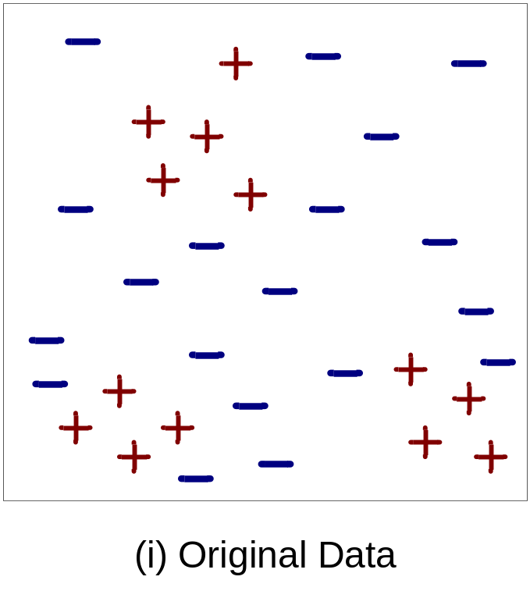
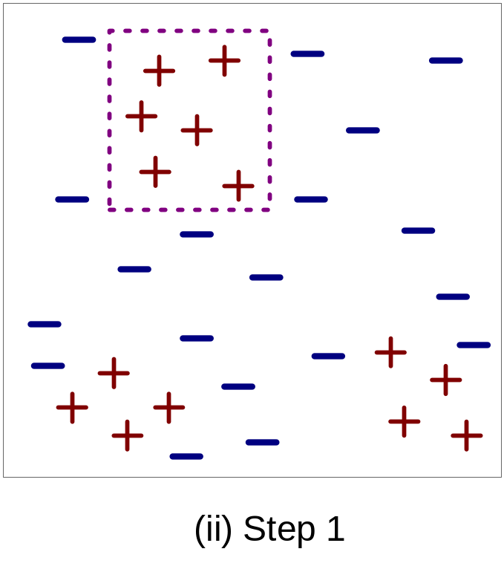
Example of Sequential Covering

Slide 104
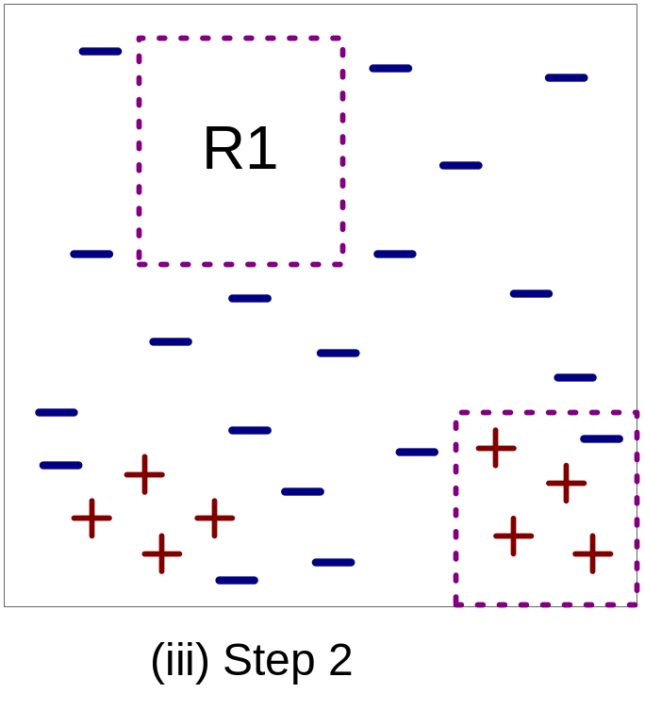
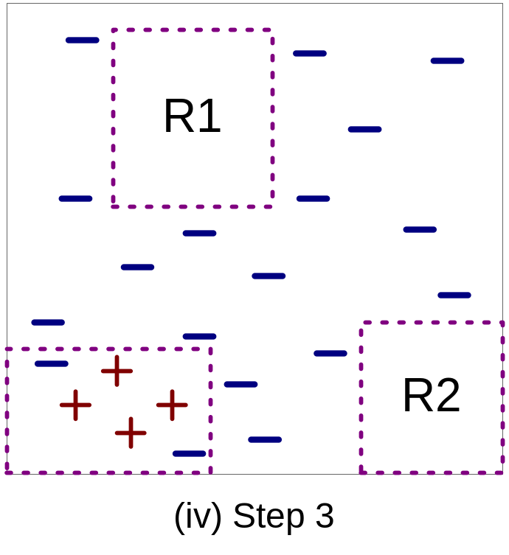
Example of Sequential Covering…

Slide 105
Aspects of Sequential Covering
Rule Growing
Instance Elimination
Rule Evaluation
Stopping Criterion
Rule Pruning

Slide 106
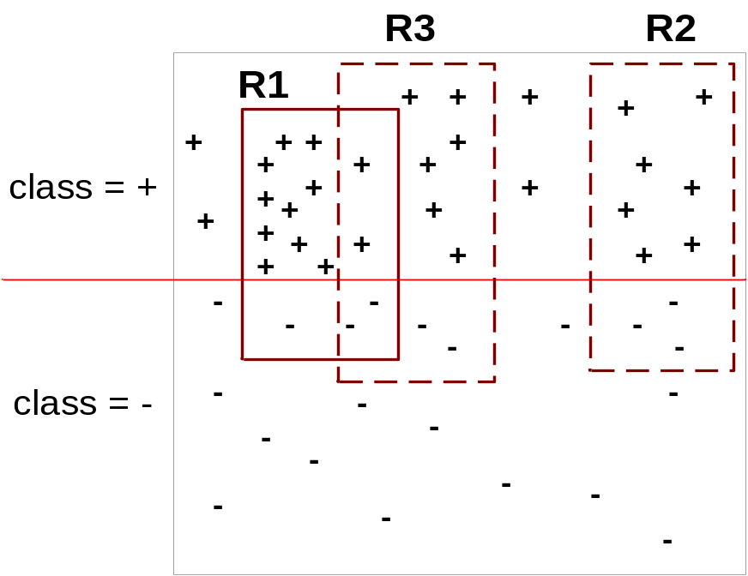
Instance Elimination
Why do we need to eliminate instances?
  Otherwise, the next rule is identical to previous rule
Why do we remove positive instances?
  Ensure that the next rule is different
Why do we remove negative instances?
  Prevent underestimating accuracy of rule
  Compare rules R2 and R3 in the diagram

Slide 107
Stopping Criterion and Rule Pruning
Stopping criterion
  Compute the gain
  If gain is not significant, discard the new rule
Rule Pruning
  Similar to post-pruning of decision trees
  Reduced Error Pruning:
    Remove one of the conjuncts in the rule
    Compare error rate on validation set before and after pruning
    If error improves, prune the conjunct

Slide 108
Advantages of Rule-Based Classifiers
As highly expressive as decision trees
Easy to interpret
Easy to generate
Can classify new instances rapidly
Performance comparable to decision trees

Slide 109
Chapter 6. Classification and Prediction
What is classification? What is prediction?
Issues regarding classification and prediction
Classification by decision tree induction
Bayesian classification
Rule-based classification
Classification by back propagation
Support Vector Machines (SVM)
Associative classification
Lazy learners (or learning from your neighbors)
Other classification methods
Prediction
Accuracy and error measures
Ensemble methods
Model selection
Summary

Slide 110
Classification: A Mathematical Mapping
Classification:
  predicts categorical class labels
E.g., Personal homepage classification
  x_{i} = (x₁, x₂, x₃, …), y_{i} = +1 or –1
  x₁ : # of a word “homepage”
  x₂ : # of a word “welcome”
Mathematically
  x ∈ X = ℜ^{n}, y ∈ Y = {+1, –1}
  We want a function f: X → Y

Slide 111
Linear Classification
Binary Classification problem
The data above the red line belongs to class ‘x’
The data below red line belongs to class ‘o’
Examples: SVM, Perceptron, Probabilistic Classifiers
x
x
x
x
x
x
x
x
o
x
o
x
o
o
o
o
o
o
o
o
o
o
o

Slide 112
SVM—Support Vector Machines
A new classification method for both linear and nonlinear data
It uses a nonlinear mapping to transform the original training data into a higher dimension
With the new dimension, it searches for the linear optimal separating hyperplane (i.e., “decision boundary”)
With an appropriate nonlinear mapping to a sufficiently high dimension, data from two classes can always be separated by a hyperplane
SVM finds this hyperplane using support vectors (“essential” training tuples) and margins (defined by the support vectors)

Slide 113
SVM—History and Applications
Vapnik and colleagues (1992)—groundwork from Vapnik & Chervonenkis’ statistical learning theory in 1960s
Features: training can be slow but accuracy is high owing to their ability to model complex nonlinear decision boundaries (margin maximization)
Used both for classification and prediction
Applications:
  handwritten digit recognition, object recognition, speaker identification, benchmarking time-series prediction tests

Slide 114
SVM—General Philosophy
Small Margin
Large Margin
Support Vectors

Slide 115


SVM—Margins and Support Vectors

Slide 116
SVM—When Data Is Linearly Separable
m
Let data D be (X₁, y₁), …, (X_{|D|}, y_{|D|}), where X_{i} is the set of training tuples associated with the class labels y_{i}
There are infinite lines (hyperplanes) separating the two classes but we want to find the best one (the one that minimizes classification error on unseen data)
SVM searches for the hyperplane with the largest margin, i.e., maximum marginal hyperplane (MMH)

Slide 117
SVM—Linearly Separable
A separating hyperplane can be written as
    W ● X + b = 0
  where W={w₁, w₂, …, w_{n}} is a weight vector and b a scalar (bias)
For 2-D it can be written as
    w₀ + w₁ x₁ + w₂ x₂ = 0
The hyperplane defining the sides of the margin:
    H₁: w₀ + w₁ x₁ + w₂ x₂ ≥ 1 for y_{i} = +1, and
    H₂: w₀ + w₁ x₁ + w₂ x₂ ≤ – 1 for y_{i} = –1
Any training tuples that fall on hyperplanes H₁ or H₂ (i.e., the
sides defining the margin) are support vectors
This becomes a constrained (convex) quadratic optimization problem: Quadratic objective function and linear constraints → Quadratic Programming (QP) → Lagrangian multipliers

Slide 118
Why Is SVM Effective on High Dimensional Data?
The complexity of trained classifier is characterized by the # of support vectors rather than the dimensionality of the data
The support vectors are the essential or critical training examples —they lie closest to the decision boundary (MMH)
If all other training examples are removed and the training is repeated, the same separating hyperplane would be found
The number of support vectors found can be used to compute an (upper) bound on the expected error rate of the SVM classifier, which is independent of the data dimensionality
Thus, an SVM with a small number of support vectors can have good generalization, even when the dimensionality of the data is high

Slide 119


SVM—Linearly Inseparable
Transform the original input data into a higher dimensional space
Search for a linear separating hyperplane in the new space

Slide 120
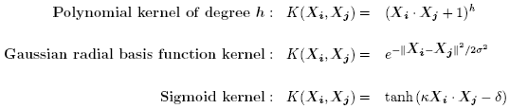
SVM—Kernel functions
Instead of computing the dot product on the transformed data tuples, it is mathematically equivalent to instead applying a kernel function K(X_{i}, X_{j}) to the original data, i.e., K(X_{i}, X_{j}) = Φ(X_{i}) Φ(X_{j})
Typical Kernel Functions
SVM can also be used for classifying multiple (> 2) classes and for regression analysis (with additional user parameters)

Slide 121
SVM—Introduction Literature
“Statistical Learning Theory” by Vapnik: extremely hard to understand, containing many errors too.
C. J. C. Burges. A Tutorial on Support Vector Machines for Pattern Recognition. Knowledge Discovery and Data Mining, 2(2), 1998.
  Better than the Vapnik’s book, but still written too hard for introduction, and the examples are so not-intuitive
The book “An Introduction to Support Vector Machines” by N. Cristianini and J. Shawe-Taylor
  Also written hard for introduction, but the explanation about the mercer’s theorem is better than above literatures
The neural network book by Haykins
  Contains one nice chapter of SVM introduction

